Slide 1
Binary number representation
Integers
Lightning talk
Greenfox
05.04.2019.

Slide 2
Decimal
…+ 10³ + 10² + 10¹ + 10⁰
Binary
…+ 2³ + 2² + 2¹ + 2⁰
To represent an integer we need:
value
+ / - (signed or unsigned)

Slide 3
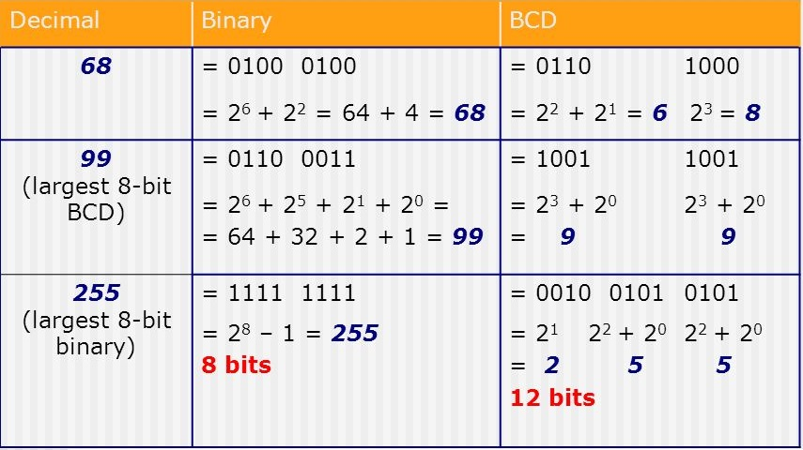
Unsigned:
Binary
BCD (Binary Coded Decimal)
BCD range of values < conventional binary representation
Notes:
Operations are easier in conventional
BCD used in business applications

Slide 4
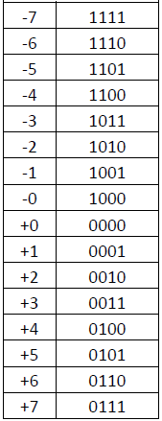
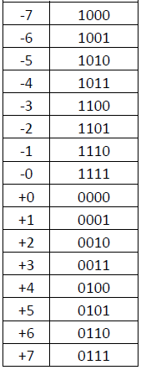
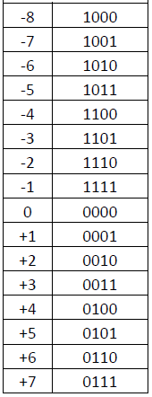
Signed
Sign and value (absolute value)
First bit from the left: 0 - positive
1 - negative
One’s complement (negated)
0 and positive are as normal
Negatives -> all the number flipped
Two’s complement
Most widely used
From 0000 turning back or forward
Notes:
Absolute value: two zeros, operations are complicated, can be used in BCD

Slide 5
One’s complement
Range (on 1 byte): -127 to +127
Example:
0101 1111_{1kB} = +95_{D}
0∙128 + 1∙64 + 0∙32 + 1∙16 + 1∙8 + 1∙4 + 1∙2 1∙1
1010 0000_{1kB} – negative
negate to get it’s absolute value
0101 1111_{B} = |95_{D}|
solution: 1010 0000_{1kB} = -95_{D}
Notes:
Alsó index: subscript

Slide 6
Two’s complement
Range (on 1 byte): -128 to +127
In one’s complement it is easier to change sign but that need extra work because of -0
Example: 0101 1111_{2kB} = +95_{D}
1010 0000_{2kB} – negative
0101 1111_{B}
1_{B}
0110 0000_{B} = |96_{D}|
1010 0000_{2kB} = -95_{D}

Slide 7
Comparison
0111 0100_{B}: conventional: 116_{D}
one’s compl.: +116_{D}
two’s compl.: +116_{D}
1101 0101_{B}: conventional: 213_{D}
one’s compl.: -42_{D}
two’s compl.: -43_{D}

Slide 8
Carry and Overflow
Carry bit: shows if value of the result is higher that can be represented
Overflow: after the addition/substraction the result is not within the range of representation

Slide 9
32bit vs 64bit CPU and OP
Processing speed
32bit can address: 2³² bytes (or ~4GB) RAM
64bit can address: 2⁶⁴ bytes (or ~18 EB = 18 billion GB) RAM

Slide 10
Thank you for your attention!

